Slide 1
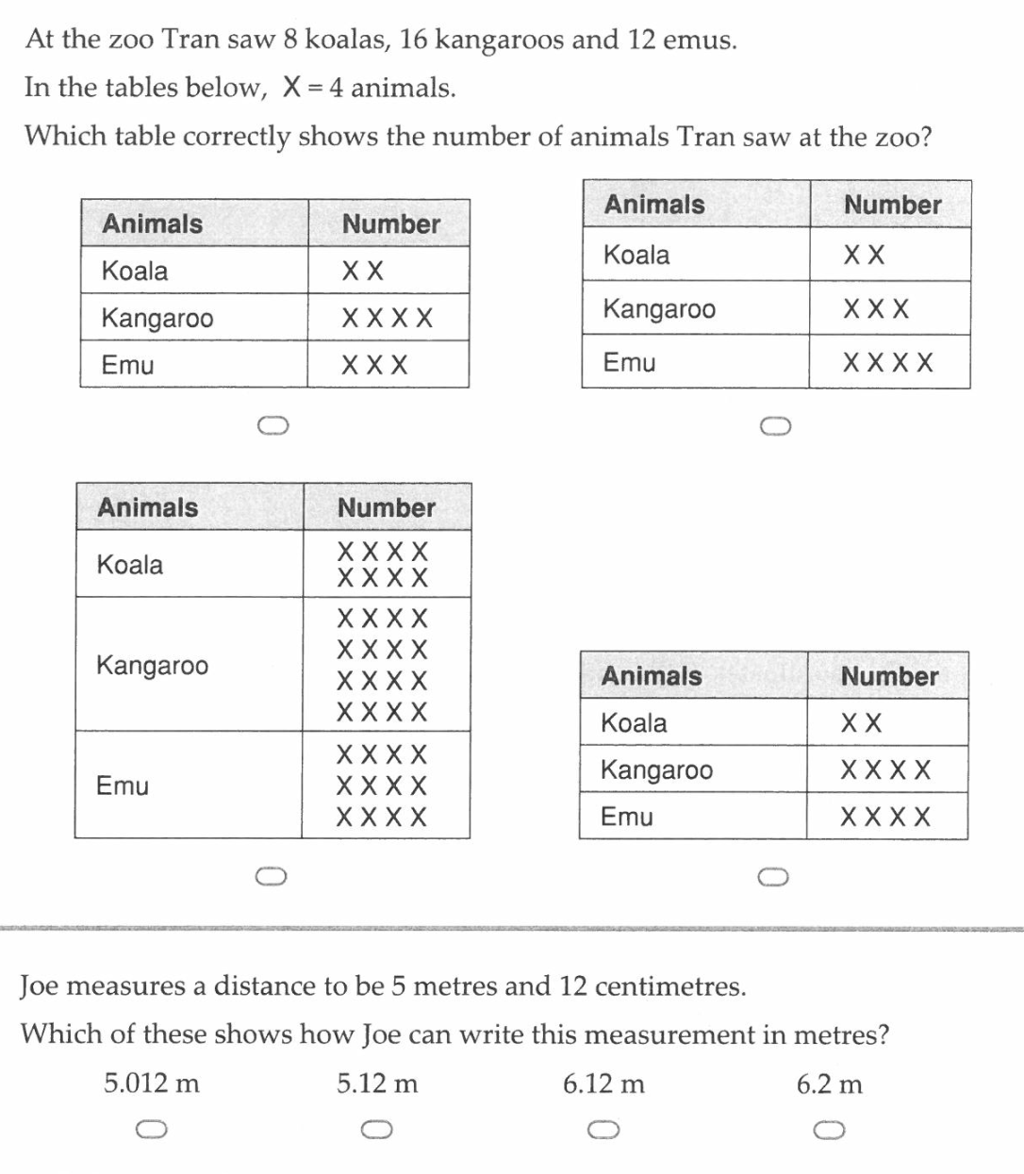
Warm Up
A B C D

Slide 2
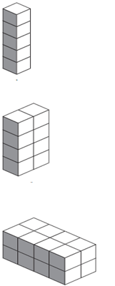
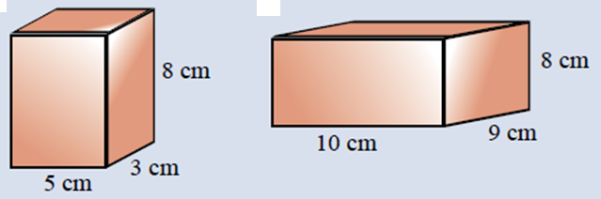
Find the Volume of the following
Notes:
hook

Slide 3
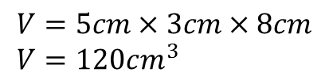




Find the Volume of the following
$$4cm^{3}$$
$$8cm^{3}$$
$$V=10cm×9cm×8cm \\ V=720cm^{3}$$
$$V=5cm×3cm×8cm \\ V=120cm^{3}$$
$$16cm^{3}$$
Notes:
hook

Slide 4
Lesson objective
By the end of this lesson you will be able to;
- Convert between the different units of volume and capacity
Notes:
Lesson

Slide 5

How many $cm^{3} are in m^{3}$?
How many 1cm cubes will fit in a 1m cube?
Task:
- In groups of 4, make a cubic meter using newspaper
- Determine how many cubic centre meters will fit in the cube.
Notes:
Hook,
You will need news paper, sticky tape, measuring tapes (meter ruler) and MAB blocks

Slide 6
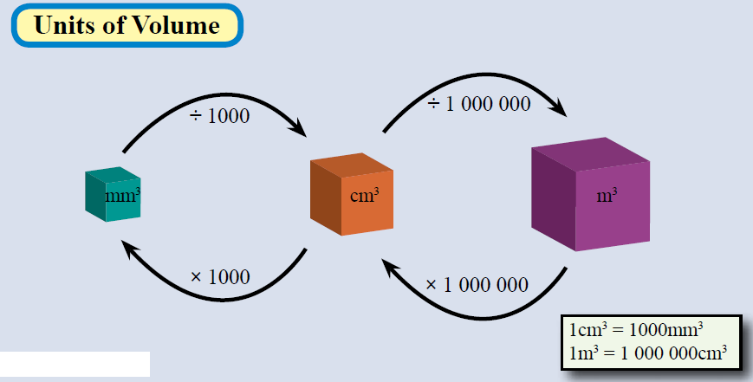
24
7
30
Date
Volume
EQ – How can we convert between volume and capacity?
Units of volume
5
Notes:
Lesson objective (EQ)

Slide 7
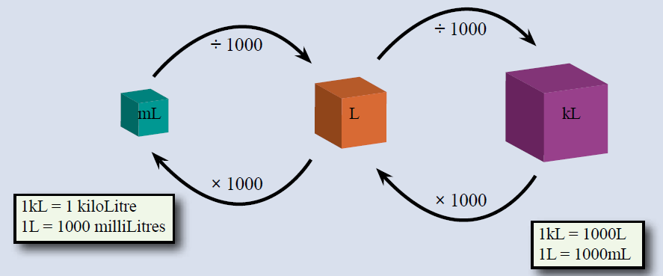
24
7
30
Date
Volume
EQ – How can we convert between volume and capacity?
Units of volume
Units of Capacity
5
Notes:
Lesson objective (EQ)

Slide 8
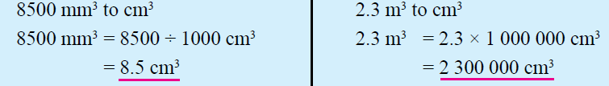

Convert the following
Notes:
Check for understanding

Slide 9
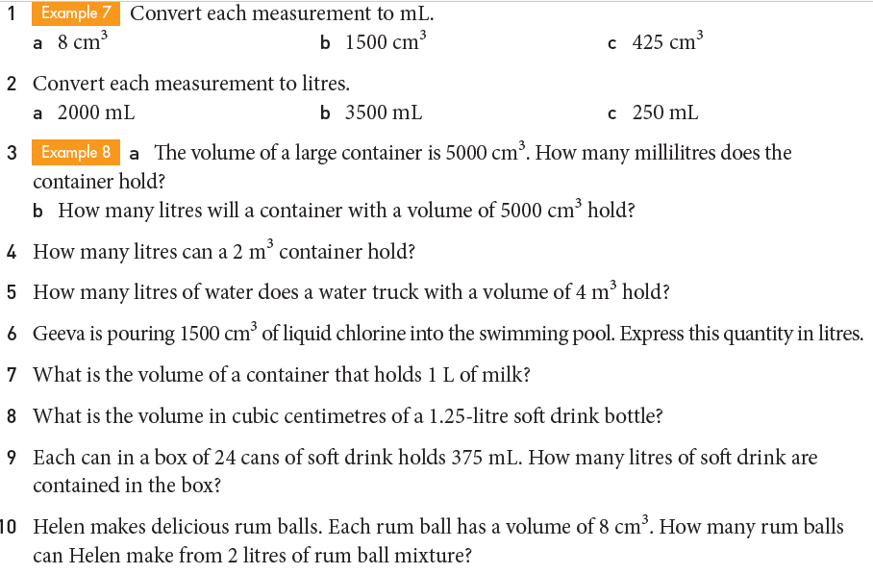
Task

Slide 10
